Slide 1
Climate Action Implementation
Shalom Watson

Slide 2
Summary of MY ACTION
My Climate Action was to influence family members and friends of taking mindful steps to reduce individual carbon footprint. I introduced them to a trending philosophy called minimalism. In doing so, I recorded certain minimalist actions, statistics, examples of extreme weather, global warming facts, and posted on various social media sites like Twitter, Facebook, and SnapChat.

Slide 3
My Message & My Audience
My main message was to introduce the idea of minimalism and the parallel ideas of thinking that include the “less is more” philosophy. My audience were mostly friends, acquaintances and distant family members who mostly agree climate change is a serious topic of concern but is skeptical on the impact of small contributions.

Slide 4
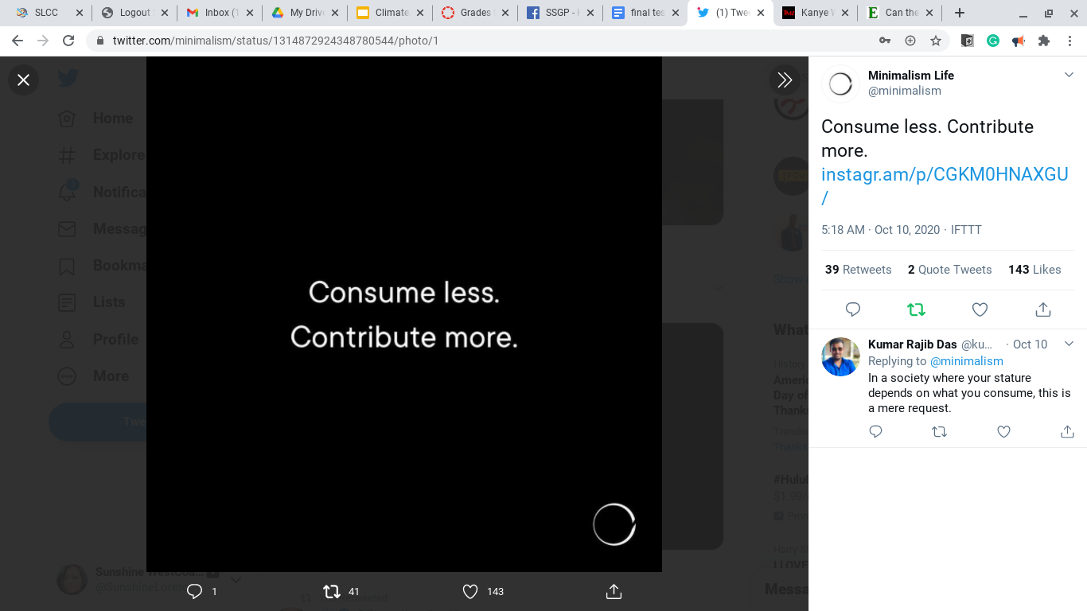
Documenting MY ACTION - Twitter
Twitter has a plethora of climate change activists and is a major channel of spreading minimalism. A simple search for “minimalism” will result in numerous memes like this which I RETWEET.
RETWEET ========>
EXAMPLE 1 =======>

Slide 5
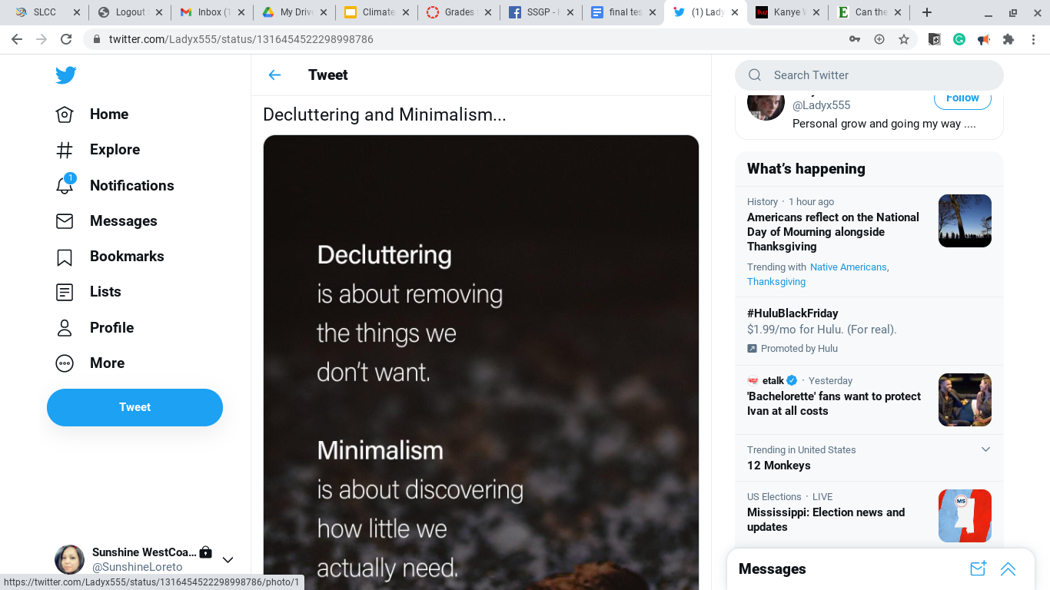
Documenting MY ACTION - Twitter (cont’d)
RETWEET EXAMPLE 2

Slide 6
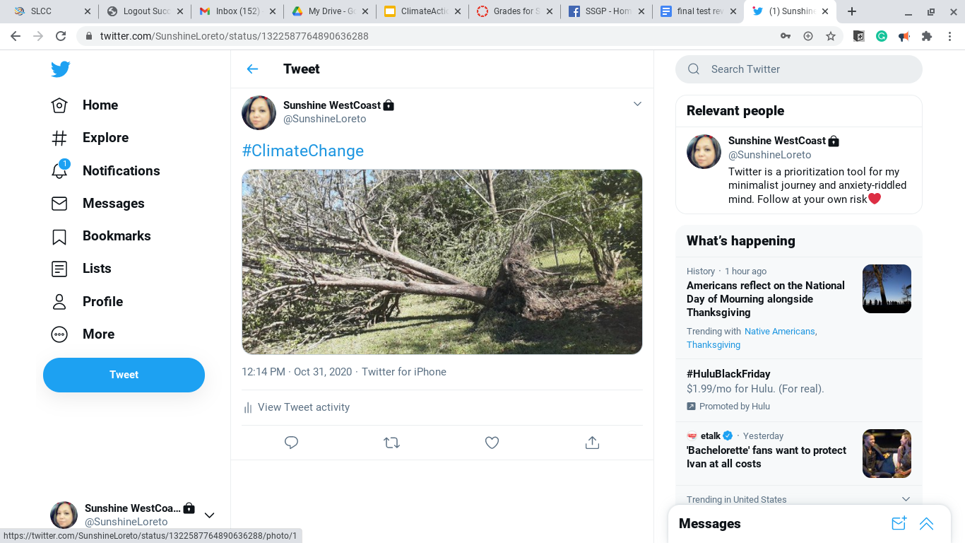
Documenting MY ACTION - Twitter (cont’d)
My property in Biloxi, MS was hit by Hurricane Zeta.
TWEET with climate change hashtag Example 3 =========>

Slide 7
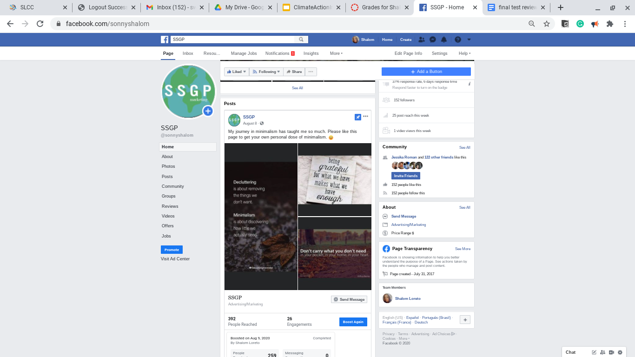
Documenting MY ACTION - Facebook (cont’d)
My Facebook page (SSGP) includes many minimalist-themed articles, memes, and climate change information. The acronym stands for Seeking Scientifically Greener Processes.
Facebook Example 1
==================>

Slide 8
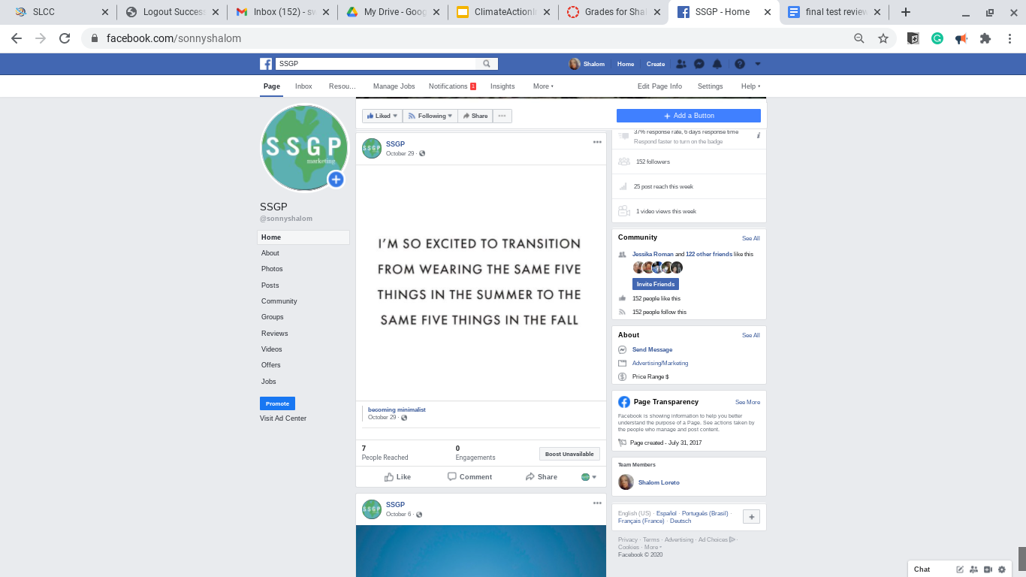
Documenting MY ACTION - Facebook (cont’d)
Facebook
Example 2
Minimalism Humor

Slide 9
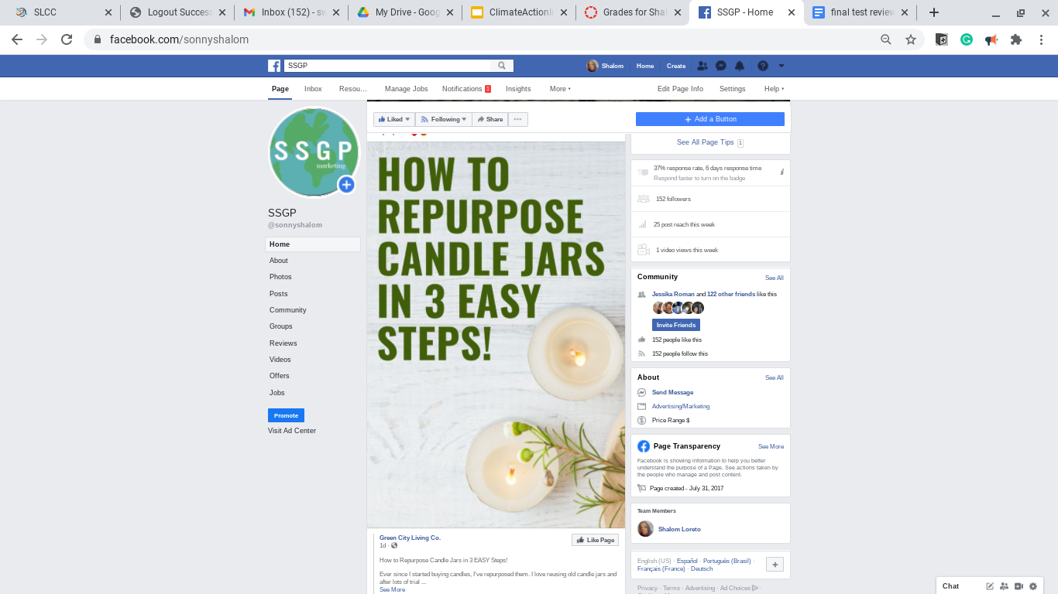
Documenting MY ACTION - Facebook (cont’d)
Facebook Example 3
Practical Minimalism for home ideas

Slide 10

Documenting MY ACTION - SnapChat (cont’d)
Weather conditions during my stay in New Orleans consisted of intermittent thundershowers. As I headed outside my hotel, one can see the streets are not prepared for normal weather much less extreme weather.
SnapChat Video Example 1 =======>

Slide 11
What Went Well?
Out of the three social media platforms I chose, Twitter and SnapChat posts were more influential than the Facebook page due to Twitter and SnapChat being more popular with millenials.
Real-life situation posts such as the hurricane and flooding examples provided enough shock value to create curiosity and conversations about climate change.
Memes about recycling craft ideas and focusing on needs instead of wants resonated well with the holiday season spirit of my audience.

Slide 12
What Didn’t Go Well?
Minimalism is a lifestyle not restricted to material things only. It also helps prioritize intangible aspects of mental health and social relationships. The effectiveness of this message was not pushed to its potential. I also had to fight my own personal experiences of climate -induced weather by dodging several hurricanes in the South. Even though it was great for content, it did do any favors for my mental health.

Slide 13
Future Directions
My Facebook page now has a dedicated content specialist. He takes photographs and selects appropriate material to keep the group interactive and fun. Since the start of the project the number of likes doubled and is catching the attention of other serious minimalists. Hopefully with this early momentum, my social media effectiveness will reach more people. Even if I am only able to influence one person with my example; my hope is that enough people

